Slide 1

Mansoura University
Faculty of Computers and Information
Department of Computer Science
League of Legends Win Prediction: A Machine Learning Approach
Submitted By
Ibrahim Mohamed Ibrahim Elsayed Hegazi
Supervisors
Dr Mohamed Abu Elsoud
Dr Mohamed Haggag
Department of Computer Science
Faculty of Computers and Information
Mansoura University

Slide 2
AGENDA
01 Problem Statement & Research Questions
06 Results: Model Performance
11 Practical Implications
02 Data Collection & Dataset Overview
07 Results: Feature Importance
12 Limitations
03 Feature Engineering Pipeline
08 Results: SHAP Analysis
13 Future Work
04 Feature Selection Methodology
09 Results: Stability Analysis
14 Contributions & Conclusion
05 Machine Learning Models
10 Key Findings & Discussion
15 Q&A
Ibrahim Hegazi | Department of Computer Science

Slide 3
INTRODUCTION
METHODOLOGY
RESULTS
DISCUSSION
CONCLUSION
Problem Statement
The Challenge
League of Legends matches generate thousands of data points across 10 players
High-dimensional, multi-entity data with complex feature interactions
Need interpretable models providing actionable insights beyond raw predictions
Research Gaps
Gap | Prior Work Limitation
Role-aware features | Team-level aggregation loses position info [Chowdhury 2024]
Feature selection rigor | Single-method selection retains redundancy [Bahrololloomi 2023]
Ensemble comparison | Limited evaluation of voting/bagging [Liang 2023]
Stability validation | Single train-test splits dominate
Interpretability | Model-specific importance only [Junior & Campelo 2023]
03

Slide 4
INTRODUCTION
METHODOLOGY
RESULTS
DISCUSSION
CONCLUSION
Research Questions
PRIMARY QUESTION
Can ML models accurately predict winning teams using post-game player statistics and position-preserving feature engineering?
Secondary Questions
RQ2 Which features most strongly predict match outcomes?
RQ3 How do different algorithms (tree-based, linear, neural) compare?
RQ4 Do ensemble strategies (bagging, voting) improve performance?
RQ5 How robust are models to variations in training data?
04

Slide 5
INTRODUCTION
METHODOLOGY
RESULTS
DISCUSSION
CONCLUSION
Data Collection & Dataset
Tier-Stratified Snowball Sampling
Tier | Divisions | Matches / Div. | Total
Iron – Diamond | 4 each (I–IV) | 50 | 1,400
Master / GM / Challenger | 1 each | 200 | 600
Total | 31 divisions | — | 2,000
2,000
Matches Collected
Across 31 divisions | 10 players per match
Data Sources
Riot Games Official API
Region: Europe Nordic & East (EUN1)
Queue: Ranked Solo/Duo only
Two CSV outputs: Team-level (objectives, bans) + Participant-level (10 players × ~200 features)
05

Slide 6
INTRODUCTION
METHODOLOGY
RESULTS
DISCUSSION
CONCLUSION
Feature Engineering Pipeline
Core Transformation: 10 rows per match → 1 row per match (preserving position info)
1
Assign team prefixes (T1/T2) based on teamId ordering
4
Merge team-level objective data with T1/T2 prefixes
2
Create player identifiers: T1_TOP, T1_JUNGLE, T2_MIDDLE, etc.
5
Construct binary target: T1_win (1 = T1 victory, 0 = T2 victory)
3
Pivot data → Features become: kills_T1_TOP, deaths_T2_JUNGLE, etc.
Result: 1,254 engineered features
06

Slide 7
INTRODUCTION
METHODOLOGY
RESULTS
DISCUSSION
CONCLUSION
Two-Stage Feature Selection
STAGE 1
STAGE 2
SULOV Correlation Analysis
XGBoost Recursive Feature Elimination
Filter method: Remove highly correlated feature pairs (ρ > 0.81)
Keep feature with higher target correlation
Result: 1,254 → 1,050 features (16.3% reduction)
Train XGBoost on standardized features
Rank by gain-based importance
Select top 15 features
Result: 1,050 → 15 features (98.5% total reduction)
WHY TWO STAGES?
SULOV eliminates redundancy; XGBoost optimizes for predictive power. Addresses limitations of single-method approaches in prior work.
07

Slide 8
INTRODUCTION
METHODOLOGY
RESULTS
DISCUSSION
CONCLUSION
Machine Learning Models
Category | Models
Gradient Boosting | XGBoost, CatBoost, Gradient Boosting
Bagging Ensemble | Random Forest
Instance-Based | K-Nearest Neighbors
Kernel Method | Support Vector Regressor (RBF)
Linear | Ridge Regression (L2)
Neural Network | Multi-Layer Perceptron
Ensembles | Bagging Regressor (10 estimators), Voting Regressor (top 3)
10
Models Evaluated (8 individual + 2 ensembles)
4
Evaluation Metrics
Configuration
GridSearchCV with 5-fold CV, scoring = R²
80/20 stratified train-test split
Regression → Classification via 0.5 threshold
6 evaluation metrics: R², Accuracy, MAE, RMSD, MAD, MAPD
08

Slide 9
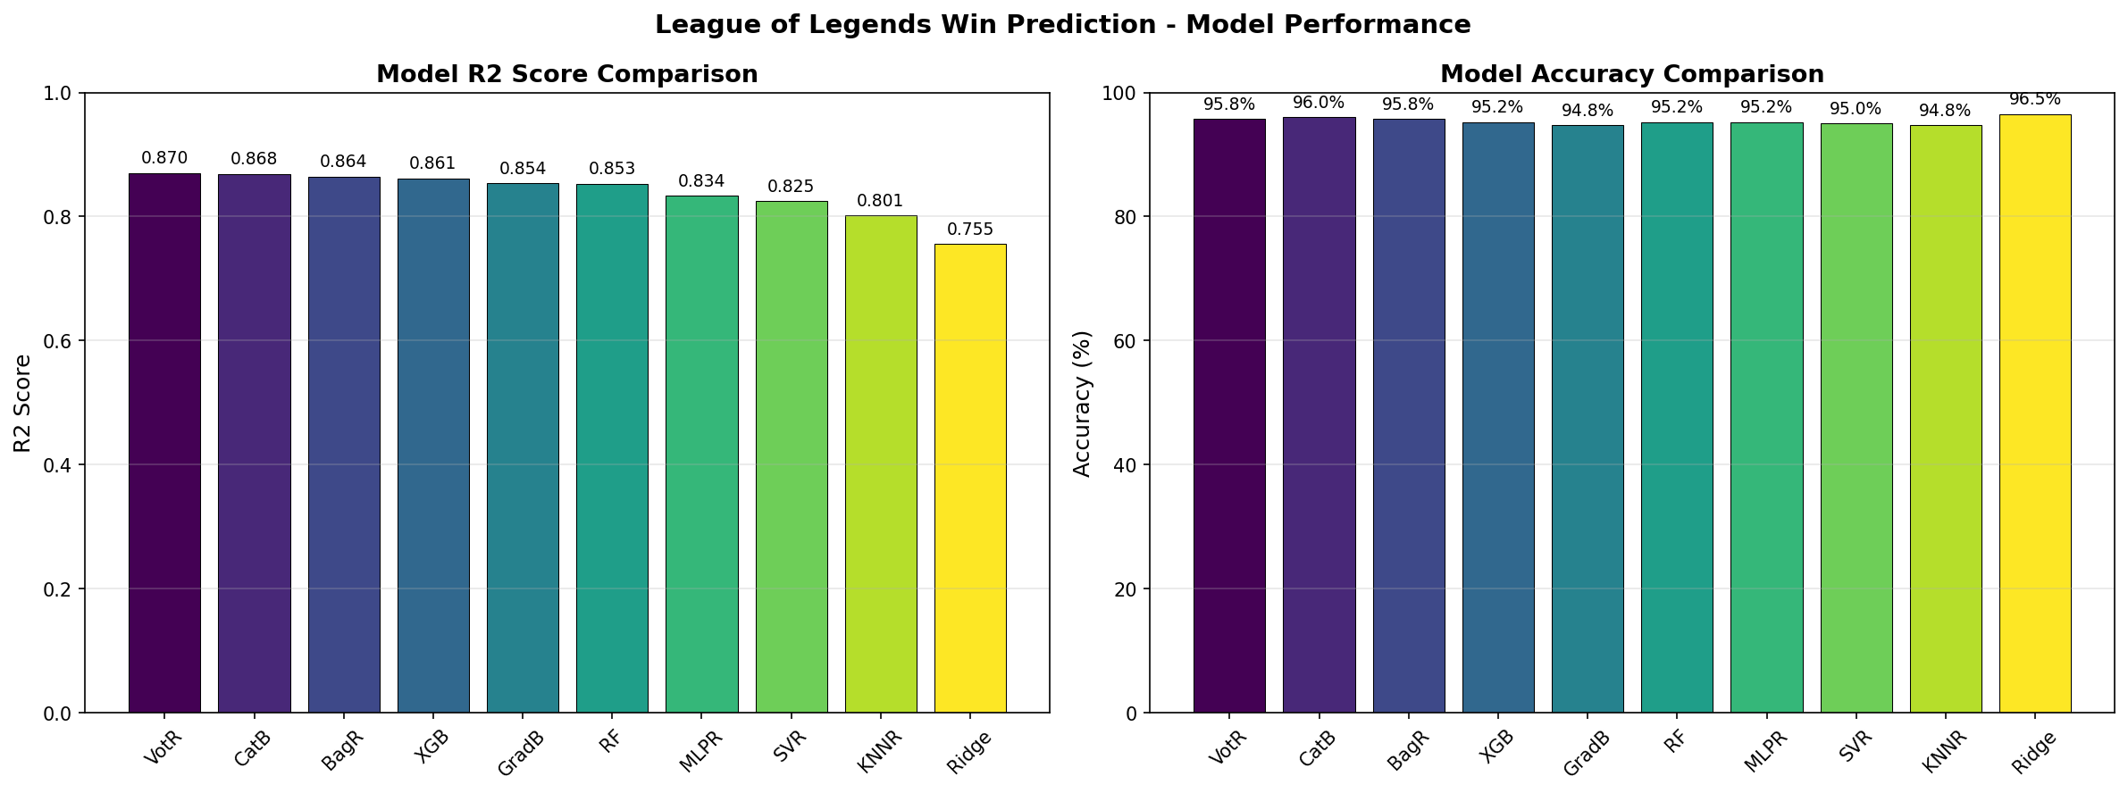
INTRODUCTION
METHODOLOGY
RESULTS
DISCUSSION
CONCLUSION
Results — Model Performance
Model | R² | Accuracy | MAE | MAD
VotR | 0.8704 | 95.75% | 0.0773 | 0.0116
CatB | 0.8684 | 96.00% | 0.0890 | 0.0230
BagR | 0.8644 | 95.75% | 0.0896 | 0.0193
XGB | 0.8613 | 95.25% | 0.0872 | 0.0164
GradB | 0.8538 | 94.75% | 0.0661 | 0.0064
RF | 0.8527 | 95.25% | 0.0651 | 0.0000
Ridge | 0.7554 | 96.50% | 0.1912 | 0.1497
09

Slide 10
INTRODUCTION
METHODOLOGY
RESULTS
DISCUSSION
CONCLUSION
Results — Feature Importance
Rank | Feature | Importance | Category | Role
1 | turretsLost_T2_TOP | 0.1694 | Structure | TOP
2 | turretsLost_T1_UTILITY | 0.1013 | Structure | SUPPORT
3 | perk_primary_rune_1_var1_T1_UTILITY | 0.0354 | Rune | SUPPORT
... | ... | ... | ... | ...
14 | deaths_T1_JUNGLE | 0.0120 | Combat | JUNGLE
15 | turretTakedowns_T1_MIDDLE | 0.0114 | Structure | MIDDLE
Category Distribution
Notable Absence: Kills, damage dealt, gold earned → NOT in top 15
10

Slide 11
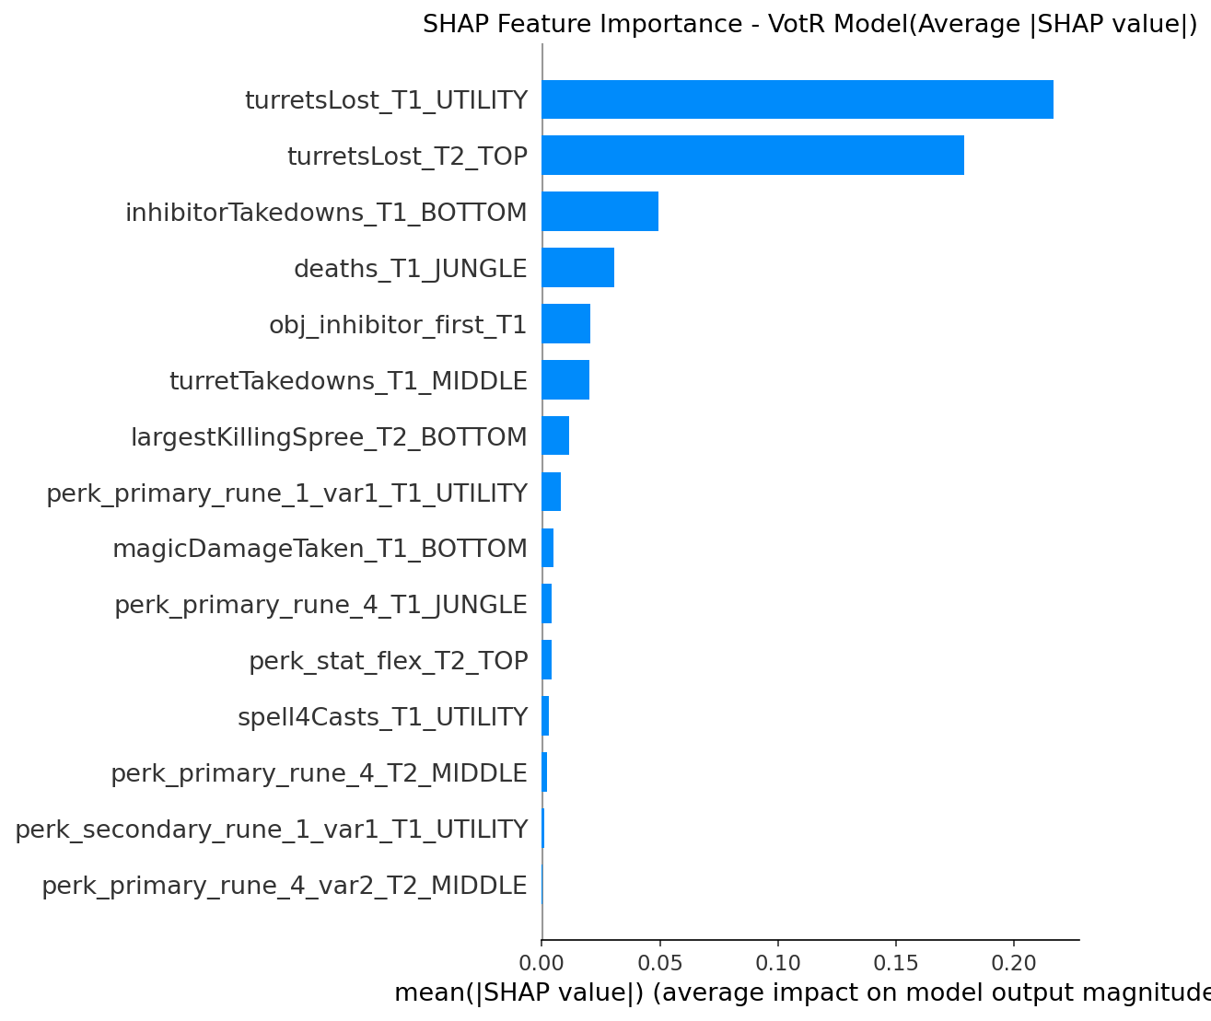
INTRODUCTION
METHODOLOGY
RESULTS
DISCUSSION
CONCLUSION
SHAP Analysis — Key Findings
Top SHAP Features
What is SHAP Analysis
A game-theory-based method that tells you exactly how much each feature contributed to a specific prediction
GridSearchCV
11

Slide 12
INTRODUCTION
METHODOLOGY
RESULTS
DISCUSSION
CONCLUSION
Stability Analysis (100 Iterations)
Metric | CatBoost | XGBoost | Grad. Boosting
Accuracy (%) | 95.52 ± 0.97 | 95.07 ± 1.01 | 95.31 ± 1.04
R² | 0.8632 ± 0.0192 | 0.8599 ± 0.0203 | 0.8630 ± 0.0242
MAE | 0.0907 ± 0.0072 | 0.0883 ± 0.0071 | 0.0698 ± 0.0074
MAD | 0.0221 ± 0.0022 | 0.0159 ± 0.0023 | 0.0061 ± 0.0012
Key Takeaways
CatBoost: Most stable (lowest σ for Accuracy & R²)
Gradient Boosting: Best calibration (lowest MAE & MAD)
All models: Performance variation within ~1% accuracy, ~0.02 R²
Deployment Guidance
Priority | Model
Reliable classification | CatBoost
Accurate probabilities | Grad. Boosting
Simple & fast | Ridge
12

Slide 13
INTRODUCTION
METHODOLOGY
RESULTS
DISCUSSION
CONCLUSION
Key Findings & Discussion
1
Structures > Kills
Turret losses dominate prediction (SHAP impact 10× larger than combat features). Validates Riot's objective-based game design.
2
Jungler Deaths Matter Most
Only combat stat in top 15 — cascading impact on objectives, map control, and resources.
3
Runes as Strategic Signals
5 of 15 features are rune configurations — pre-game choices signal playstyle and meta awareness.
4
The "Missing" Offensive Stats
Kills, damage dealt, gold earned are NOT top predictors. Preventing negative outcomes > achieving positive outcomes.
5
Ensemble Benefit is Modest
VotR improves R² by only 0.002 over CatBoost. CatBoost alone offers near-ensemble performance.
13

Slide 14
INTRODUCTION
METHODOLOGY
RESULTS
DISCUSSION
CONCLUSION
Practical Implications
For Players
For Coaches
For Researchers
Protect turrets — highest impact on win probability
Keep Jungler alive — most predictive combat metric
Don't obsess over KDA — kills don't predict wins
Evaluate Support via structure metrics, not combat stats
Prioritize Herald control → direct structure damage
Track Jungler death patterns as KPI
Use SHAP over model-specific importance
Report stability metrics (mean ± σ)
Match evaluation metric to application need
14

Slide 15
INTRODUCTION
METHODOLOGY
RESULTS
DISCUSSION
CONCLUSION
Limitations
Category | Limitation
Data | Single region (EUN1), specific patch period
Prediction | Post-game only — not real-time
Causality | Predictive association ≠ causal influence
Generalization | May not extend to professional play
Feature Selection | SULOV threshold (0.81) and top-15 are design choices
15

Slide 16
INTRODUCTION
METHODOLOGY
RESULTS
DISCUSSION
CONCLUSION
Future Work
SHORT-TERM
MEDIUM-TERM
LONG-TERM
Temporal feature engineering for real-time prediction
Multi-region data collection for cross-region validation
Champion embeddings & graph neural networks for synergy modeling
Cross-patch transfer learning for meta-shift adaptation
Causal discovery methods → distinguish correlation from causation
Deployment: Live win probability tools for players & broadcasters
16

Slide 17
INTRODUCTION
METHODOLOGY
RESULTS
DISCUSSION
CONCLUSION
Contributions
METHODOLOGICAL
EMPIRICAL
Position-preserving feature engineering pipeline
Two-stage feature selection (SULOV + XGBoost RFE)
Comprehensive evaluation (4 metrics + 100-iteration stability + SHAP)
Open-source code release
Structure objectives dominate prediction (10× SHAP impact)
Runes as strategic signals, not direct predictors
Stability-performance trade-off documented (CatB vs. GradB)
17

Slide 18
INTRODUCTION
METHODOLOGY
RESULTS
DISCUSSION
CONCLUSION
Conclusion
CAN WE PREDICT LEAGUE OF LEGENDS WINNERS?
Yes — with 95.75% accuracy and R² = 0.87
What Predicts Victory?
What's the Best Model?
Structures first — Turrets and inhibitors are 10× more predictive than combat stats
Jungler survival — Most impactful individual metric
Rune choices — Strategic signals, not direct causes
Goal | Best Model
Winner ID | Ridge (96.5%)
Probability | Gradient Boosting
Balanced | CatBoost
Max R² | Voting Regressor
Open Source: Full code available for reproduction & extension
18

Slide 19
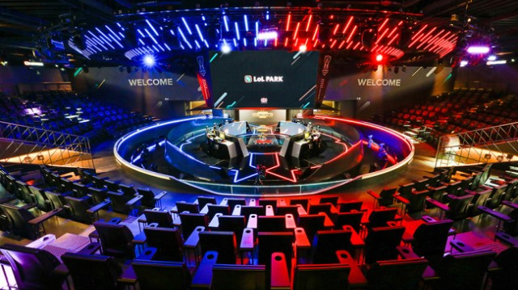
THANK YOU
Questions & Discussion
ihegazi@std.mans.edu.eg
KEY REFERENCES
Chowdhury et al. (2024) — Linear & ensemble LoL prediction
Bahrololloomi et al. (2023) — Role-aware player metrics
Lundberg & Lee (2017) — SHAP unified interpretability
Chen & Guestrin (2016) — XGBoost

